Slide 1
SOFTWARE DRAWING
2D SHAPES AND
3D GRAPHICS

Slide 2
Group Members (Group 50)
ISHAAN OBEROI | IIT2021155
JAI MORYANI | IIT2021122
ROHAN KUMAR BEHERA | IIT2021145

Slide 3
Abstract
In this project, we are drawing 2D Shapes such as Squares, Circles, Stars etc along with 3D Graphics such as Cubes, Cylinders, Spheres. There are buttons to control the rotation of the shapes. In addition to this, there are buttons to change the colors of the shapes as well as control their rotation in different orientations.

Slide 4
Technology Used
Java: Java is a high-level, class-based, object-oriented programming language used worldwide for making applications. We have used Java as the language of choice for our project and the rich collection of libraries available in Java (Swing and FX) to make our GUI and other components. Collection framework classes like Vector are used for storing and manipulating the data as per our need.

Slide 5
Java Swing: Swing is a Java Foundation Classes [JFC] library and an extension of the Abstract Window Toolkit [AWT]. Swing offers much-improved functionality over AWT, new components, expanded components features, excellent event handling with drag and drop support. We have built a Jframe in our application where a tabbed pane holds two different panels for 3D and 2D shapes. Different 2D shapes are directly used from already available shape classes in Swing. JOptionPane, JButtons etc. are some other Swing features used in our project.

Slide 6
Java FX: JavaFX is an open source, next generation client application platform for desktop, mobile and embedded systems built on Java. By making a separate Thread for running FX components, we integrated those components into a JFXPanel which supports both Swing and FX and added the JFXPanel to the tabbed pane. The different shapes already available 3D shapes in Java FX are used saving us from making our own implementation for these classes.

Slide 7
Table of contents
01.
02.
Features Implemented
Important Steps
03.
04.
Pseudo Code/ Algorithm
UML Diagrams

Slide 8
Table of contents
05.
06.
Working
Screenshots
07.
08.
Challenges.
Demo VIdeo

Slide 9
01.
Features Implemented

Slide 10
Features Implemented
Users can choose the type of shape they want to see i.e 2D or 3D.
For 2D Shapes:
A. Users can choose among 6 2D Shapes namely, Square, Ellipse, Triangle, Rectangle, Circle & Star.
B. Users can control the type of rotation and color of the shape.
For 3D Graphics:
A. Users can choose among three 3D Graphics namely, Cube, Sphere & Cylinder.
B. Users can choose whether they want to view the rotation or not.

Slide 11
02.
Important Steps

Slide 12
Important Steps
Generated a frame of size 800x800 to display the shapes.
Made a list of 2D shapes & 3D shapes and users using vector.
Added input, option and message dialog box using JOptionPane.
Added 2D EventListeners & 3D EventListeners by implementing ActionListener.

Slide 13
Important Steps
To display and rotate 3D shapes, we used javaFX.
Made buttons namely, Rotate Clockwise, Rotate Anticlockwise and Change Colour.
To generate random colours, we used Math.random() function.
Shifted each new shape by an angle of 1.0 degree on each click.

Slide 14
03.
UML Diagrams

Slide 15
Use Case Diagram
Link to Use Case Diagram

Slide 16
SCOPE –
We describe what features are in the scope of the software and what are not in the scope of the software to be developed.
In Scope – Drawing 2D Shapes
Drawing 3D Shapes
Rotation of 2D and 3D Shapes
Out of Scope – Animation of Shapes
Rotation by dragging
Custom dimensions

Slide 17
USER CHARACTERISTICS – User should be familiar with using Computer Programs and applications built using Java.
PRINCIPAL ACTORS – Any user who executes and runs the program.
GENERAL CHARACTERISTICS – “World of Shapes” is a single user application, every user must have this application installed on their personal computers.
ASSUMPTIONS AND DEPENDENCIES –
User must have Java JDK installed on their device
User must have installed appropriate JAR files required for functioning of the program

Slide 18
Use Case | Description
Actor | User who executes the program
Enter | User enters the program
Enter Name | Allows users to enter their name
Choose Dimensions | Allows users to choose the dimension of the shape
Choose Shape | Allows users to choose the type of shape
Start | Starts the Main program
Stop | Allows the user to exit the program
ActionListener | Helps perform rotation of shapes by button clicks
Shape Rotation | Rotates the shape as per the choice of user
Display Shape | Displays the rotated shape
Change Color | Changes the color of the shape.
Clockwise Rotation | Rotates the shape in clockwise direction.
AntiClockwise Rotation | Rotates the shape in anticlockwise direction

Slide 19
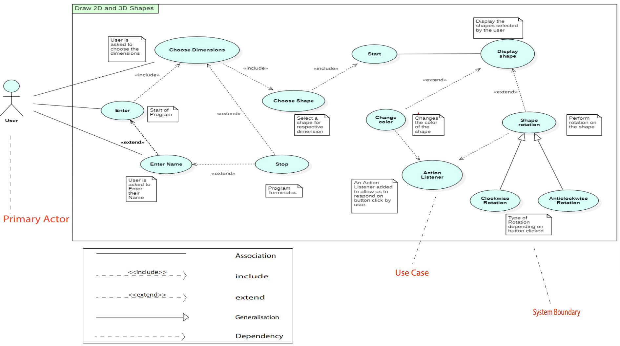

Slide 20
OBJECT-ORIENTED RELATIONSHIPS –
Include – When a use case is depicted as using the functionality of another use case, the relationship between the use cases is named as include relationship.
Extend – Extend is a directed relationship that specifies how and when the behaviour defined in usually supplementary (optional) extending use case can be inserted into the behaviour defined in the extended use case.
Generalisation – A generalization relationship is a parent-child relationship between use cases. The child use case is an enhancement of the parent use case.
Dependency – Shows that a use case depends on another use case for some functionality.
Association –Associations represent lines of communication between actors and use cases.

Slide 21
FUNCTIONAL REQUIREMENTS -
USE CASE – 1
NAME – Enter
SUMMARY – User enters the Program
MAIN SUCCESS SCENARIO – User clicks the ‘OK’ button
POST – CONDITION – NIL
USE CASE – 2
NAME – Enter Name
SUMMARY – Allows user to enter their name
MAIN SUCCESS SCENARIO – User enters an acceptable name
EXTENSION – Invalid name. Program terminates
POST – CONDITION – User can now select the dimensions of the shape

Slide 22
USE CASE – 3
NAME – Choose Dimensions
SUMMARY – Allows user to choose the dimensions of the shape
PRE – CONDITIONS – User entered an acceptable name
MAIN SUCCESS SCENARIO – User selects at least one dimension
EXTENSION – No selection. Program terminates
POST – CONDITION – User can now choose the shape of the
chosen dimension
USE CASE – 4
NAME – Choose Shape
SUMMARY – Allows user to choose the type of shape
PRE – CONDITIONS – User must have selected at least one dimension
MAIN SUCCESS SCENARIO – User chooses the desired shape

Slide 23
USE CASE – 5
NAME – Start
SUMMARY – Starts the Main program
PRE – CONDITIONS – User selected all the valid options
previously
MAIN SUCCESS SCENARIO – User can initiate the rotation
procedure
POST – CONDITION – User can now perform rotation on the
shapes
USE CASE – 6
NAME – Stop
SUMMARY – Allows user to exit the program
MAIN SUCCESS SCENARIO – Program successfully terminates

Slide 24
USE CASE – 7
NAME – Action Listener
SUMMARY – Helps perform rotation of shapes through button
clicks
PRE – CONDITIONS – User clicks button for rotation.
MAIN SUCCESS SCENARIO – The required system routine is
invoked.
USE CASE – 8
NAME – Display Shape
SUMMARY – Displays the rotated shape.
MAIN SUCCESS SCENARIO – The shape is displayed successfully.
POST – CONDITION – User can further rotate the shape now.

Slide 25
USE CASE – 9
NAME – Shape rotation
SUMMARY – Rotates the shape as per the choice of user
PRE – CONDITIONS – User has chosen to rotate the shape
MAIN SUCCESS SCENARIO – The Shape rotates.
EXTENSION – User exits. Program terminates
POST – CONDITION – User can rotate shape either clockwise or
anticlockwise.
USE CASE – 10
NAME – Change Color
SUMMARY – Changes the color of the shape.
PRE – CONDITIONS – Clicking button for change color or button
for rotation.
MAIN SUCCESS SCENARIO – Shape will change color to random
RGB values.

Slide 26
USE CASE – 11
NAME – Clockwise Rotation
SUMMARY – Rotates the shape 1 degree in clockwise direction.
PRE – CONDITIONS – Clicking button for clockwise rotation.
MAIN SUCCESS SCENARIO – Shape rotates by 1 degree in
clockwise direction.
USE CASE – 12
NAME – Anticlockwise Rotation
SUMMARY – Rotates the shape 1 degree in anticlockwise
direction.
PRE – CONDITIONS – Clicking button for anticlockwise rotation.
MAIN SUCCESS SCENARIO – Shape rotates by 1 degree in
anticlockwise direction

Slide 27
Class Diagram
Link to Class Diagram

Slide 28
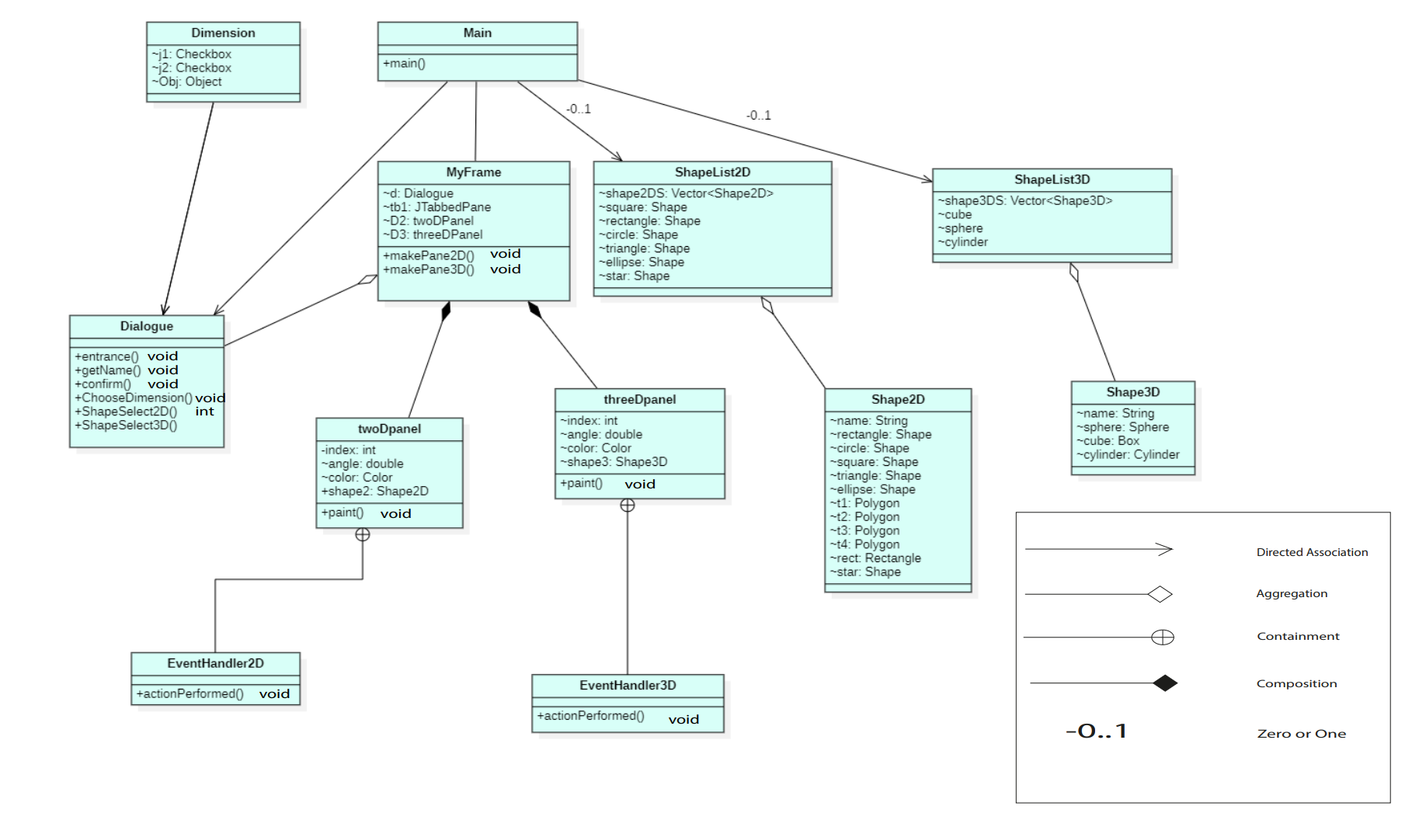

Slide 29
OBJECT-ORIENTED CLASS RELATIONSHIPS
Directed Association – This is a one-directional relationship in a class diagram that ensures the flow of control from one to another classifier. The navigability is specified by one of the association ends.
Aggregation – Aggregation implies a relationship where the child can exist independently of the parent.
Composition – Composition implies a relationship where the child cannot exist independent of the parent.
Containment – Uses the class as a data member in the class.
O…1 Relationship – Zero or one objects of this class is takes place in the relationship

Slide 30
CLASS DESCRIPTIONS -
1.Main
a) Description: contains the main executing code for the
application. Starts the thread for FX and initialises the
Swing components.
b) Inner Classes Used: MyFrame inherited from JFrame.
2.Shape2D:
a) Description: It contains all the 2D shapes present in the
given project such as circle, square, rectangle, ellipse, star.
This class uses the shape already available in awt.
3.Shape3D:
a) Description: It contains all the 3D shapes used in the
project such as sphere, cube and cylinder. Uses classes
already available in FX.

Slide 31
4.ShapeList2D:
a) Description: It contains the list of all the 2D shapes
present in the given project.Used for selecting which
shape to show.
5.ShapeList3D:
a) Description:It contains the list of all the 3D shapes
present in the given project. Used for selecting which
shape to show.
6.threeDPanel:
a) Description: It contains all the 3D components in the
project. This is the canvas for our 2D shapes.
b) Parent Class: JFXPanel
c) Inner Classes Used: EventHandler

Slide 32
7.twoDPanel:
a) Description: contains all the 2D components in the
project. This is the component for our 3D shapes.
b) Parent Class: JPanel
c) Inner Classes Used: EventHandler2D
8.Dialogue:
a) Description: Prompts the users for input of name,
choice of shapes
9.Dimension:
a) Description: Contains 2 checkboxes to denote our choice
of which type of shapes to rotate.

Slide 33
CRC Diagram
Link to CRC Diagram

Slide 34
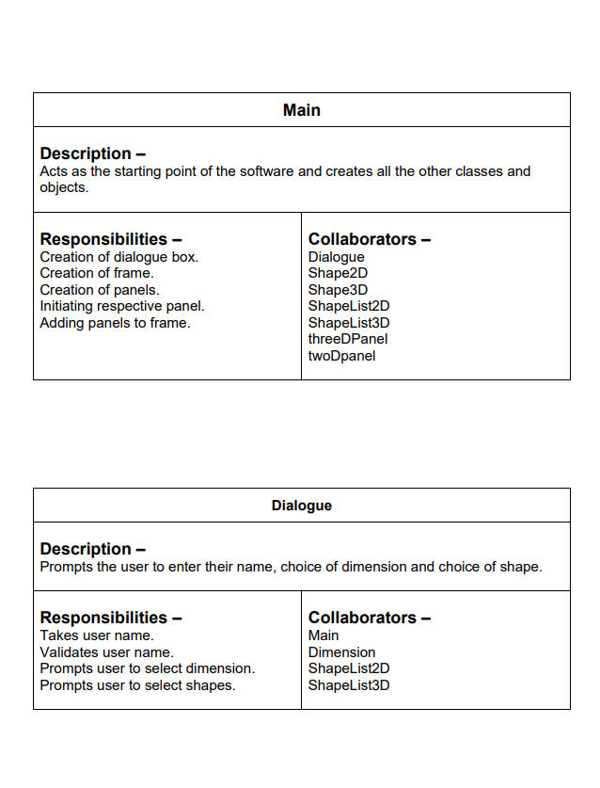
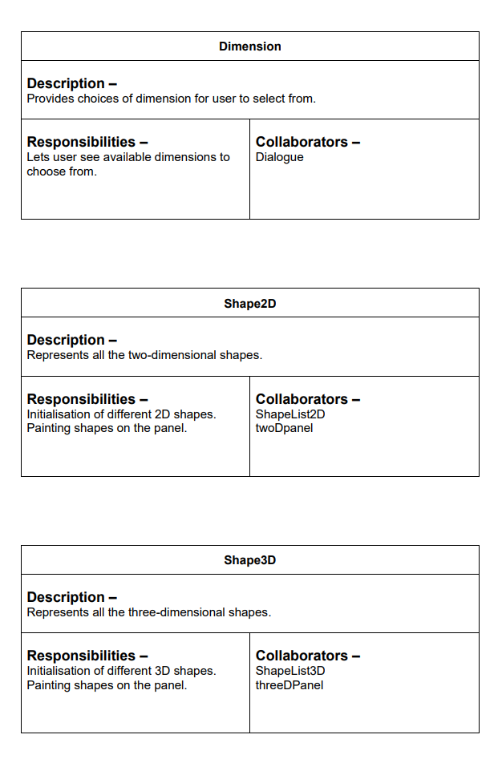

Slide 35
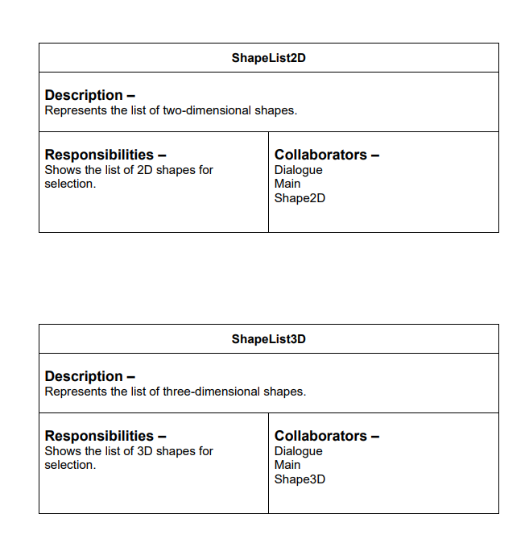
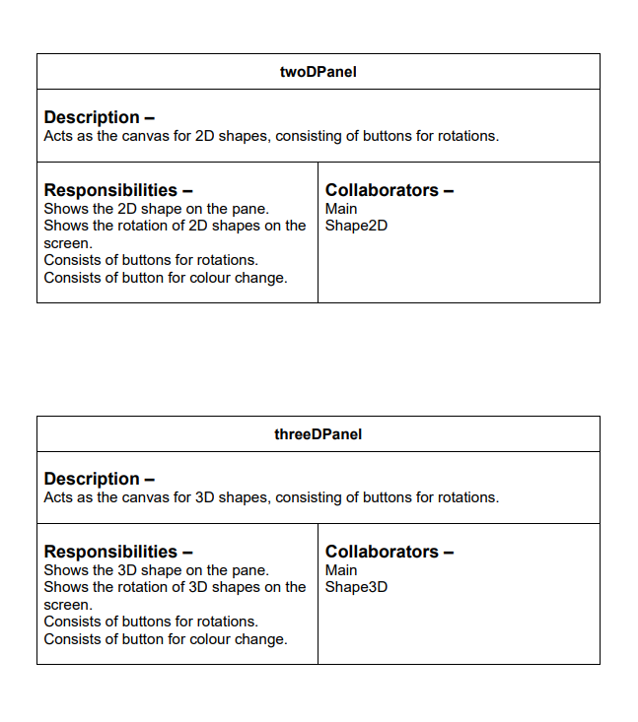

Slide 37
Sequence Diagram
Link to Sequence Diagram

Slide 38
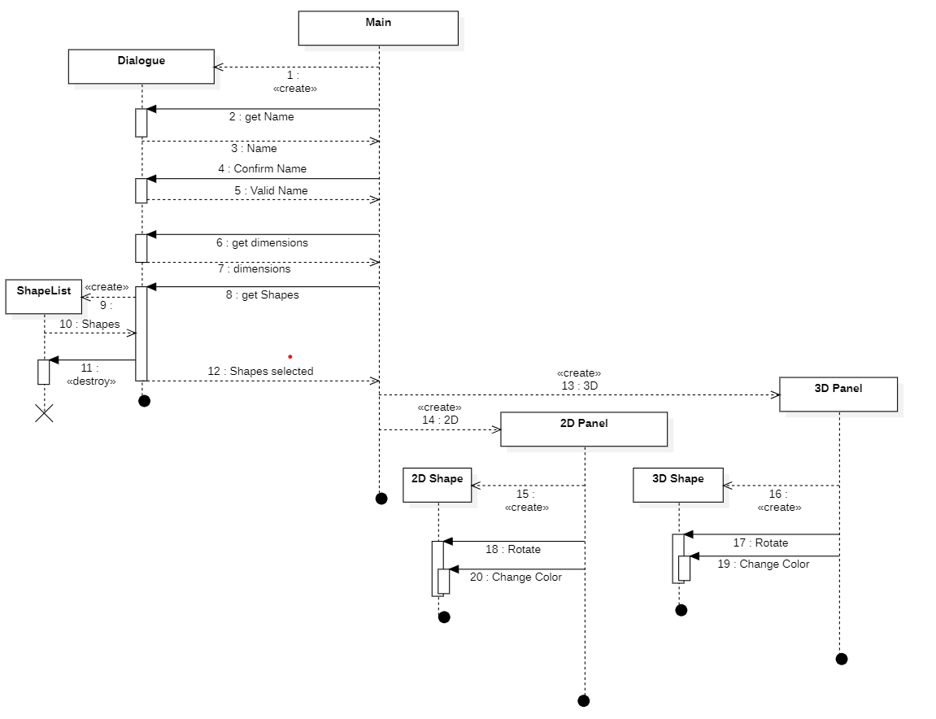

Slide 39
04.
PSEUDOCODE/ALGORITHM
Link to Code Files

Slide 40
Step 1: Create a MyFrame (inherited from Jframe) and initialise its component objects and add a tabbed pane to it. Ask the framework to show the Frame.
Create frame();// New frame
Add tabbedPane();
Frame.setVisible();
Step 2: Prompt the user to input his name, panels he/she wants to add the tabbed pane and shape to view using a JOptionPane.
JOptionPane.showOptionDialog(Dimensions); //Dimensions contains choice for 2D/3D
JOptionPane.showOptionDialog(Shapes); //All available choices will be shown.

Slide 41
Step 3: Depending upon the choice, initialise the 2D/3D panel and add the shape selected to the panel along with buttons.
Create XDPanel();
XDPanel.add(Shape);
XDPanel.add(Buttons); //All 3 buttons are added.
Step 4: Add eventListener to buttons to make code respond to the event generated by the OS upon button click. The EventHandler will change angle of shape using Rotate class.
Button.addEventListener(EventHandler());
Step 5: The GUI thread will now loop and keep asking OS for any event generated. Whenever any event is generated the GUI will ask application code to handle it to reflect the changes.

Slide 42
05.
Working

Slide 43
Working
Users are prompted for a valid name and choice.
If they provide an invalid name or choose NO as a choice, the software will terminate.
Otherwise, the software will prompt the users to choose between 2D and 3D dimensions.

Slide 44
Working
Depending on the option selected, we will show either 2D, 3D or both as the tabbed pane(s) showing the respective shapes chosen and the buttons for rotations ( clockwise and anti-clockwise ) and change color.

Slide 45
06.
Screenshots

Slide 46
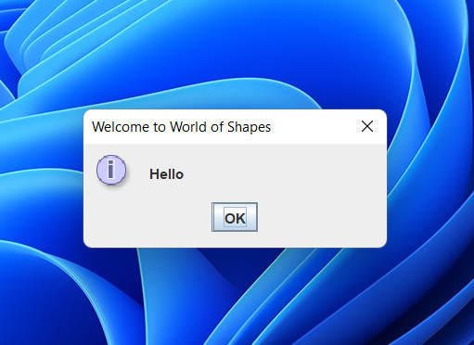
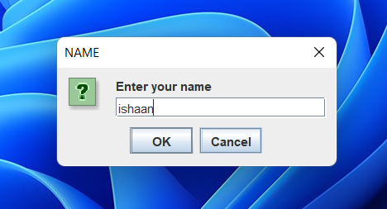
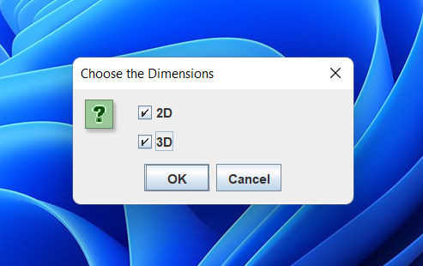
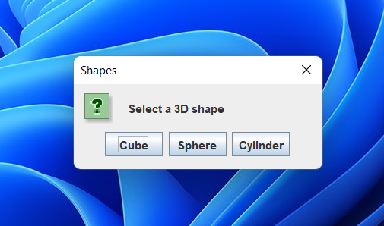

Slide 47
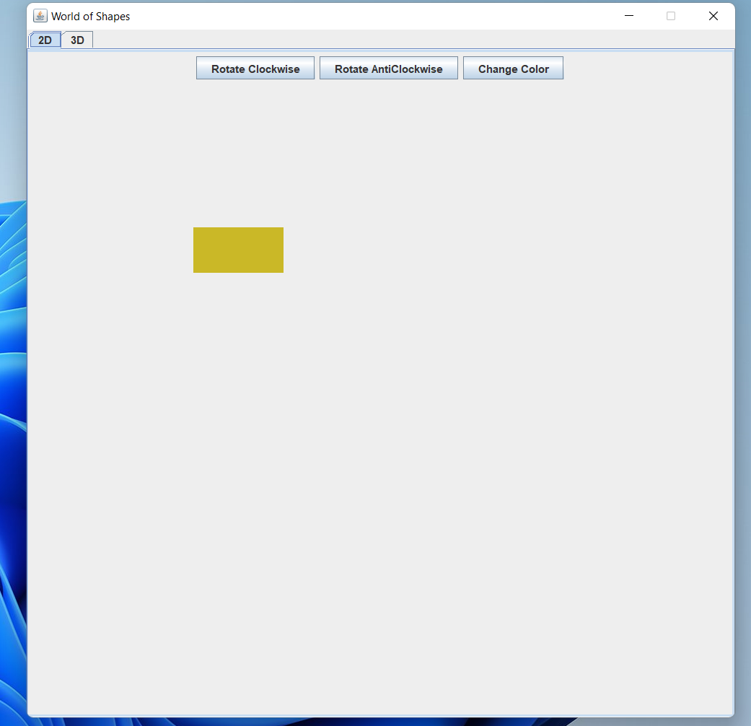

Slide 48
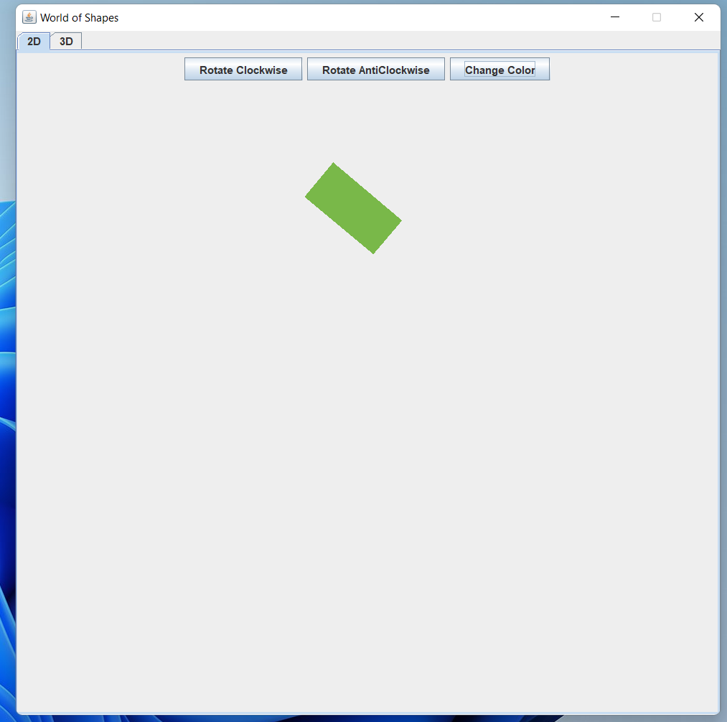

Slide 49
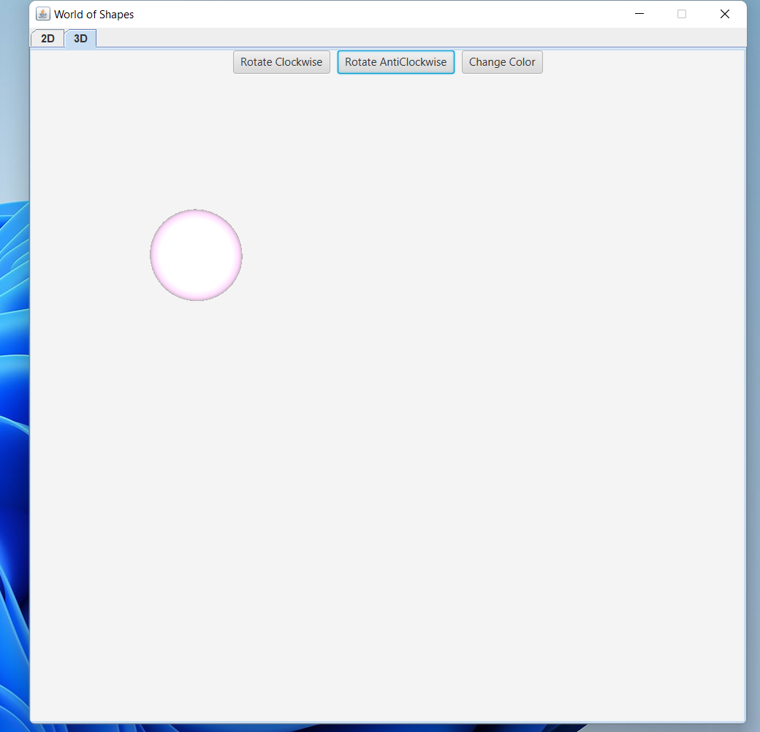

Slide 50
07.
Demo
Video

Slide 51
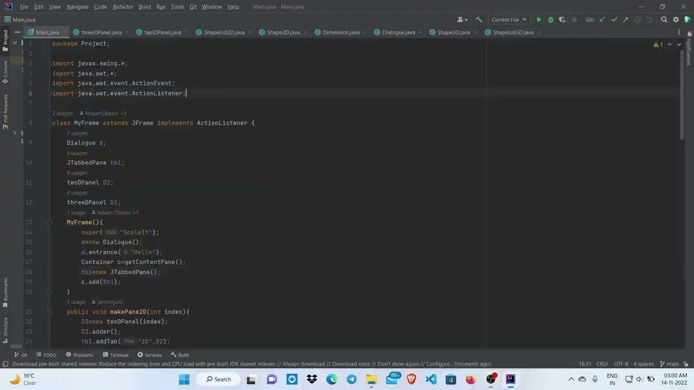
Demo Video
Video demonstrating code compilation and execution through source code.

Slide 52
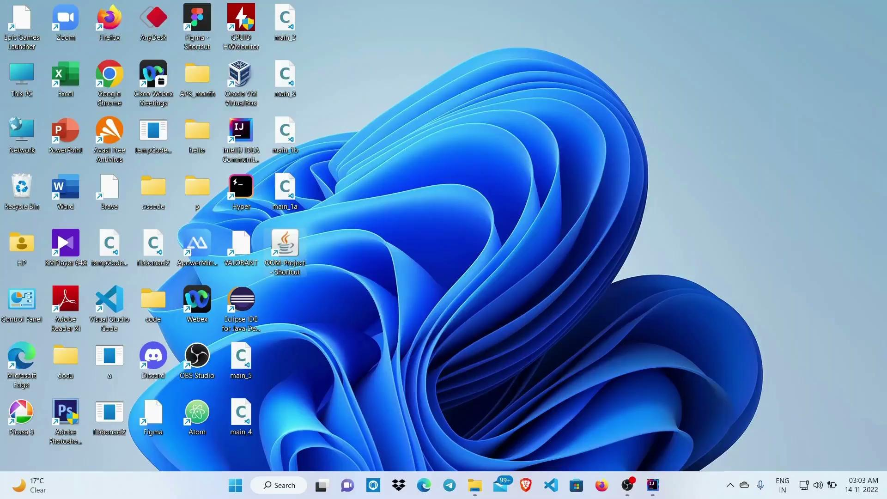
Demo Video
Video demonstrating direct execution as a ‘.jar’ file after deployment of the project.

Slide 53
08.
CHALLENGES

Slide 54
Challenges
Our Java application doesn’t supports user authentication, anyone can use it without having authorisation ,thus causing a security breach.
Our application does not have a multiple user support. If more than one user(s) want to use the application at the same time, it will not be possible for them to do so.
Users only have a limited range of shapes to choose from.
Amount of rotation is limited to 2 directions and amount of rotation is predefined, not set by the user.

Slide 55
THANK YOU !

